Slide 1

Sleep Hygiene
Sarah-Anne Schumann MD MPH
sa.mettamd@gmail.com
Fresh Rx March 2026

Slide 2
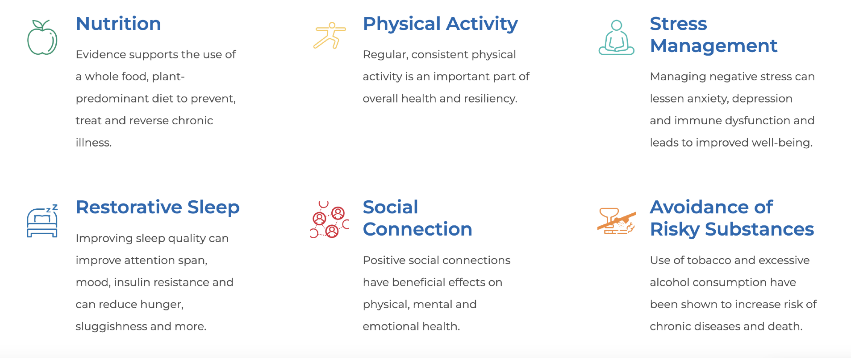

Pillars of Lifestyle Medicine

Slide 3
Why Do We Need Sleep?
Improves memory and learning
Helps regulate emotions
Dreams help with creativity and to process painful memories
Boosts immune system, microbiome, lowers blood pressure
Regulates glucose and appetite
Glymphatic system
  drainage system for brain
  clears waste products (including beta-amyloid) during sleep

Slide 4
How Much Sleep is Enough?
Sleep time that allows a person to be wide awake, alert, and energetic throughout the day
  After waking up in the morning could you fall back asleep at 10am?
  If you didn’t set an alarm would you keep sleeping for a long time?
  Are you having trouble remembering what you just read or saw?
National Sleep Foundation recommends adults get 7-8 hours per night
2/3 of adults don’t get enough sleep
5-8% of adults are “long sleepers”-need >9 hours per night
5% are functional “short sleepers”-need less than 6 hours per night

Slide 5
Risks of Not Getting Enough Sleep
Weight gain
Worse control of blood glucose (sugar)
Car accidents; 1 traffic death per hour in US caused by drowsy driving (more than alcohol and drugs combined)
Dementia
Depression, anxiety
Heart disease
High blood pressure
Inflammation
Higher risk of infections

Slide 6
Sleepiness: Adenosine
Adenosine is a brain chemical that increases during the day, highest at bedtime; makes you feel sleepy
During sleep, brain removes adenosine so you feel awake in the morning
Reduced by sleeping (napping in evening makes it hard to sleep at bedtime)
Caffeine affects how brain reacts to adenosine (why coffee keeps you awake)
When you don’t sleep enough, adenosine levels stay high all day so you feel tired

Slide 7
Circadian Rhythms
  Powerful internal clock that affects sleep/wake pattern and how you feel
  How can you help this clock work well?
    Exposure to light during the day
    Try to have a regular schedule for bedtime and waking up every day

Slide 8
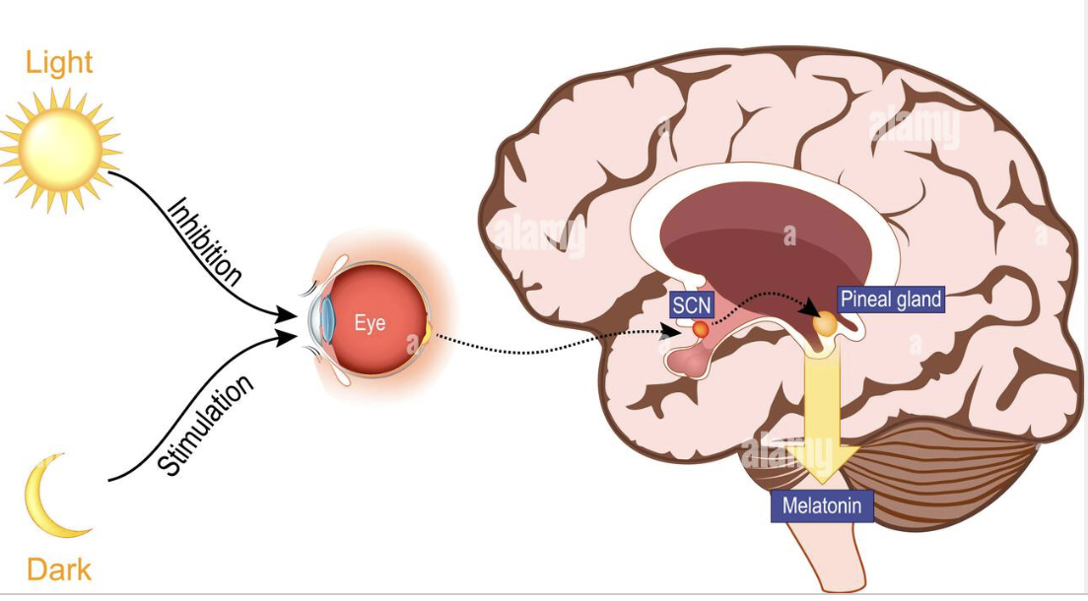
Melatonin
Night darkness leads brain to release melatonin; helps you fall asleep (doesn’t help you stay asleep)
Level drops during sleep
Causes warming of hands and feet and cooling of core body temperature and signals body to sleep
Blue light (from phones and tv and computer screens) can interfere with melatonin release
Production decreases as you get older

Slide 9
Melatonin Supplements
  Helps some people fall asleep if taken in early evening (when not expected by body)
  not regulated, many have contaminants
  Higher doses not more effective (more side effects)
  Can interact with other medications so check with your primary care provider before taking
  Foods with melatonin can be better option (will discuss at end of presentation)

Slide 10
Sleep Hygiene
What are some things you can do to sleep better?

Slide 11
Sleep Hygiene
  Go to bed and get up at the same time (bedtime alarm)
  Quiet, dark, cool bedroom
  Avoid eating before bed
  Go to bed only when tired
  No screen time or eating in bed
  If you can’t fall asleep after 15-20 minutes, leave room and only return when tired
Exercise (not just before bedtime)
Avoid caffeine after noon
Avoid alcohol before bed
Don’t nap after 3pm
Relaxing bedtime routine
Warm bath/shower
Sunshine exposure at least 30 minutes daily

Slide 12
What is Insomnia?
Most common sleep problem
More common in women than men
When you can’t sleep well even when you spend 7-9 hours in bed
Can be a problem falling asleep or staying asleep or waking up too early

Slide 13
Insomnia Treatment: CBT-I
Best first choice treatment for insomnia (better than medicine)
Identify negative attitudes/beliefs that interfere with sleep and replace with positive thoughts
Reinforce helpful sleep habits and discourages unhelpful behaviors
  Sleep hygiene
  Can include sleep restriction technique
6-8 weekly sessions individual or group—based (National Sleep Foundation)
Free app CBT-I Coach

Slide 14
Sleep Apnea
Sleep disorder when people stop breathing during sleep, blocked airway
Symptoms:
  Night-time: loud snoring, stop breathing during sleep, wake up frequently
  Day-time: headache, tired, feeling grumpy, hard to concentrate
Who is at risk?
  Family history, heart disease, large tonsils, obesity, more common in men than women
Complications: atrial fibrillation, high blood pressure, heart failure, harder to control blood sugar
Treatment: weight loss, stop smoking, oral appliances, CPAP, surgery
Talk to your PCP if you think you might have sleep apnea (sleep study needed)

Slide 15

Supplements for sleep
Lemon verbena helped with insomnia in some trials
Chamomile can improve sleep quality
Vitamin D can improve sleep quality and duration
Lavender scent; small effect
Talk to your PCP!! Supplements can interfere with medicines and aren’t regulated

Slide 16
Prescription sleep medications
Mostly help to fall asleep faster
Quality of sleep isn’t as good as natural sleep
side effects: memory loss, next day feeling tired, slow reaction times
Many are addictive
Some can cause insomnia when you stop taking them
Association with falls at night, infection, cancer, fatal car crashes, heart attack, stroke, premature death
***Talk with your PCP about medicines as sometimes they are needed

Slide 17

Napping
Short naps 15-30 minutes fine if very sleepy
Best time to nap is 7-9 hours after morning wake up time (mid-afternoon)
Nap at same time each day if possible
Nap in bed (associate bed with sleep) and set alarm to avoid sleeping too long
Avoid if have insomnia

Slide 18
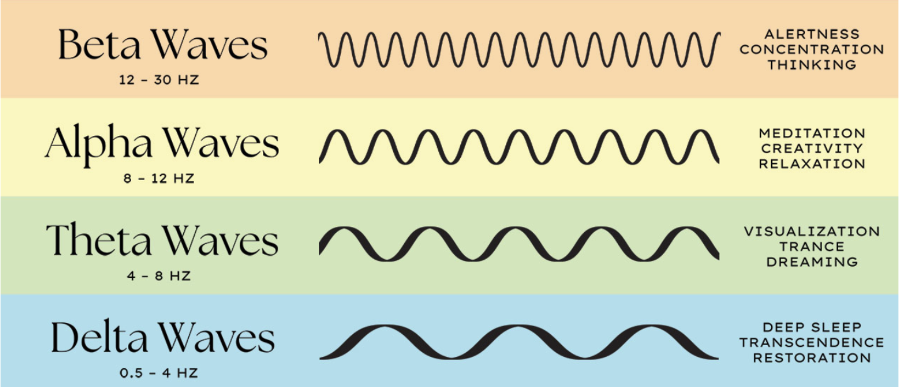
Non-Sleep Deep Rest (NSDR)
Benefits of Yoga Nidra:
Improved sleep and overall well-being
Reduced stress, anger, anxiety, and depression
Lower blood pressure
Increased immune function and reduced inflammation
Less tension headaches and pain
Boosts energy/alertness

Slide 19

Physical Activity and Sleep
Exercise 4-8 hours before bedtime can help with sleep
  Fall asleep faster
  Wake less in middle of night
Can increase levels of adenosine which helps with sleep
Improves quality of sleep
Gentle stretches before bed can be helpful
People exercise less after bad night of sleep

Slide 20
Risky Substances and Sleep
Caffeine
  Lowers adenosine so you don’t feel tired
  Stays in your system for more than 5 hours, longer in older people
  Decaf coffee still has some caffeine (don’t drink at night)
Alcohol: can help you fall asleep but less deep sleep; avoid within 3 hours of bedtime
Nicotine: Don’t smoke! Can keep you awake at night

Slide 21

Stress Reduction and Sleep
Gentle yoga
Relaxing music
Gratitude journal
Worry journal
Breathing exercises (box breath, belly breathing, longer exhales)
Mindfulness/meditation

Slide 22

Bedtime Meditation/Breath Practice

Slide 23
Nutrition and Sleep
Sugary foods and eating a lot of meat can cause worse sleep
Avoid late night eating, especially large meals close to bedtime; can lead to indigestion or reflux which interfere with sleep
Ideally stop eating 2-3 hours before bedtime
If at risk for low blood sugar, a small snack with protein and fiber ok between last meal and bedtime (nuts, apple with peanut butter, hummus and cut vegetables)
Not sleeping enough makes you hungrier and can cause weight gain

Slide 24
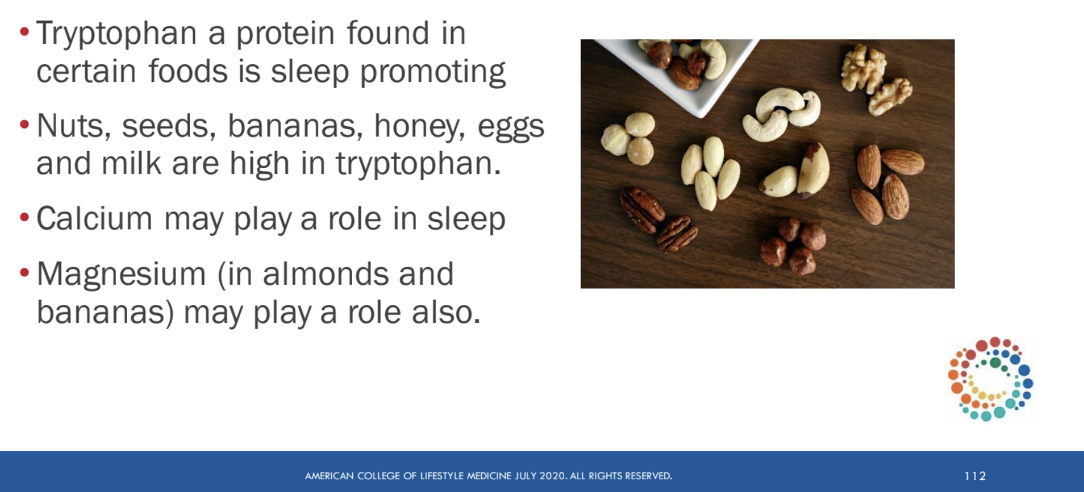
Snack Before Bed?

Slide 25

Melatonin:
Food Sources
Fruit: tart cherries, bananas, grapes
Orange bell peppers
Mushrooms
Tomatoes
Nuts: pistachios, walnuts, almonds
Flax seed
Spices: fenugreek, mustard seeds
Fatty Fish: salmon, sardines

Slide 26

Golden Milk
Almond, soy and cow milk all have tryptophan
Spices: increase melatonin, help with digestion, reduce inflammation:
Cinnamon (increases melatonin)
Cardamom (phytomelatonin)
Turmeric (less inflammation)
Ginger (aids digestion)
Cloves (decrease pain)

Slide 27
SMART Goals
Specific - What are you going to do?
Measurable - How often/for how long? Able to track progress
Achievable - Do you have what it takes to follow through?
Realistic - What can you actually do? (improvement over perfection)
Time-Bound - How frequent? How long will you commit?

